Slide 1
SCHEMA REFINEMENT
IE2042 | DMSS | Lecture 3 | Dr. Harinda Fernando

Slide 2

Learning Outcomes (LO1)
Understand the importance of schema refinement
Explain the properties of good decomposition
Understand functional dependencies
Ability to compute keys from a set of functional dependencies in a relation
Apply normal forms
IE2042 | DMSS | Lecture 3 | Dr. Harinda Fernando

Slide 3
Schema Refinement
The relations resulted through logical DB design may be good or bad
How we group attributes are very important
If there are too many attributes;
Waste Space
Anomalies
salary
ename
designation
eid
Employee
did
dlocation
dname
Employee
eid | ename | designation | salary | did | dname | location
IE2042 - DMSS - Lecture 4 – Dr. Harinda Fernando
IE2042 | DMSS | Lecture 3 | Dr. Harinda Fernando

Slide 4
Why Schema Refinement?
Insertion Anomaly
Inserting a new employee to the emp table
Department information is repeated (ensure that correct department information is inserted)
Inserting a department with no employees
Impossible since eid cannot be null
Deletion Anomaly
Deleting the last employee from the department will lead to loosing information about the department
Update Anomaly
Updating the department’s location needs to be done for all employees working for that department
IE2042 | DMSS | Lecture 3 | Dr. Harinda Fernando

Slide 5
Functional Dependency
Functional dependency is a relationship that exists when one attribute uniquely determines another attribute
For example: Suppose we have a student table with attributes: id, name, age
id attribute uniquely identifies the name attribute of student table, because if we know the student id we can tell the student name associated
This is known as functional dependency and can be written as id->name or in words we can say name is functionally dependent on id or name is functionally determined by id
Redundancies in relations are based on functional dependencies
Normalization is based on keys and functional dependencies
IE2042 | DMSS | Lecture 3 | Dr. Harinda Fernando

Slide 6
Types of Functional Dependencies
Trivial (X, Y → X)
Semi-Trivial ( X, Y → Y Z)
Non-Trivial (X → Z)
Multi-Valued (X → Y, X → Z)
Transitive (X → Y, Y → Z)

Slide 7
Decomposition
eid | ename | designation | salary | did
1000 | Ajith | Lecturer | 60000 | 1
1001 | Sunil | Executive | 45000 | 3
1002 | Kamal | Lecturer | 75000 | 1
1003 | Piyumi | Manager | 50000 | 2
1004 | Roshan | Lecturer | 35000 | 1
1005 | Nuwan | Lecturer | 80000 | 1
1006 | Jayamini | Assistant | 25000 | 2
1007 | Nishani | Lecturer | 42000 | 1
1008 | Amal | Assistant | 28000 | 4
did | dname | location
1 | Academic | Malabe
2 | Admin | Metro
3 | Maintenance | Kandy
4 | ITSD | Matara
Random decompositions may introduce new problems
Consider the following properties to overcome the problems;
Loss-Less Join Property
Dependency Preserving Property
IE2042 | DMSS | Lecture 3 | Dr. Harinda Fernando

Slide 8
Why Schema Refinement?
eid | ename | designation | salary | did | dname | location
1000 | Ajith | Lecturer | 60000 | 1 | Academic | Malabe
1001 | Sunil | Executive | 45000 | 3 | Maintenance | Kandy
1002 | Kamal | Lecturer | 75000 | 1 | Academic | Malabe
1003 | Piyumi | Manager | 50000 | 2 | Admin | Metro
1004 | Roshan | Lecturer | 35000 | 1 | Academic | Malabe
1005 | Nuwan | Lecturer | 80000 | 1 | Academic | Malabe
1006 | Jayamini | Assistant | 25000 | 2 | Admin | Metro
1007 | Nishani | Lecturer | 42000 | 1 | Academic | Malabe
1008 | Amal | Assistant | 28000 | 4 | ITSD | Matara
Any duplicates?
Any issues during insert / update / delete?
IE2042 | DMSS | Lecture 3 | Dr. Harinda Fernando

Slide 9
Loss Less Join Property
Ability to recover the original relation from the decomposed relations
R1 R2
S | P | D
S1 | P1 | D1
S2 | P2 | D2
S3 | P1 | D3
S | P
S1 | P1
S2 | P2
S3 | P1
P | D
P1 | D1
P2 | D2
P1 | D3
S | P | D
S1 | P1 | D1
S1 | P1 | D3
S2 | P2 | D2
S3 | P1 | D1
S3 | P1 | D3
S
R₁
R₂
Spurious Tuples
IE2042 | DMSS | Lecture 3 | Dr. Harinda Fernando

Slide 10
Dependency Preserving Property
Ability to enforce the constraints on the original relation, simply by enforcing constraints on each decomposed relation
R (A,B,C,D,E)
F={AB->C , D->E}
R1 (A,B,C,D) R2 (C,D,E)
F={AB-> C} F={D->E}
IE2042 | DMSS | Lecture 3 | Dr. Harinda Fernando

Slide 11
Activity 01
Consider the Employee Entity and write three functional dependencies that can exist in the Employee table.
IE2042 | DMSS | Lecture 3 | Dr. Harinda Fernando

Slide 12
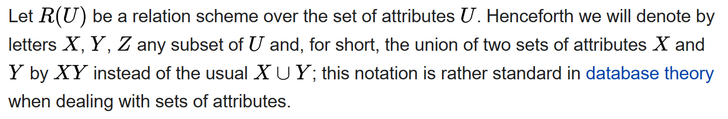
Armstrong Axioms
Can be used to identify all functional dependencies that exist on a relation
7 rules exist
3 primary
6 secondary – proven using the primary rules
Notation

Slide 13
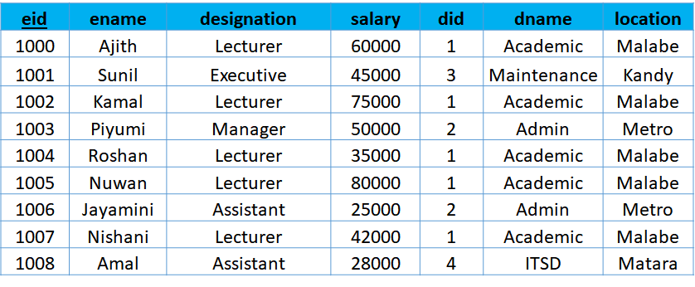
Armstrong Axioms
Reflexivity
If X ⊆ Y, then Y → X
Augmentation
If X → Y, then XZ → YZ for any Z
Transitivity
If X → Y and Y → Z, then X → Z
IE2042 | DMSS | Lecture 3 | Dr. Harinda Fernando

Slide 14
Armstrong Axioms
Union
If X →Y and X → Z, then X → YZ
Composition
If X →Y and A → B, then XA → YB
Decomposition
If X → YZ, then X → Y and X → Z
Pseudo Transitivity
If X → Y and YZ → W then XZ → W

Slide 15
Attribute Closure
Set of attributes that could be determined by an attribute
Closure is obtained by repeatedly using the axioms
Denoted by [X]+
If X+ = All attributes, then X is a CANDIDATE KEY
R (A, B, C) F = {A->B , A->C}
Closure of A; A+ = {A, B, C}
IE2042 | DMSS | Lecture 3 | Dr. Harinda Fernando

Slide 16
Attribute Closure
IF R (A,B,C,D, E) and FD {A → B, B → C, C → D, D → E}
Find closure of A and BC
Consider A
A → A (Reflexivity)
A → B (Given)
A → C (Transitivity)
A → D (Transitivity)
A → E (Transitivity)
Therefore A+ = {A, B, C, D, E,}

Slide 17
Keys - Revision
Super Key – set of attributes which uniquely identify all attributes
Candidate Key – Super key which cannot have any columns removed
Primary Key – candidate key chosen to be the main key
Important for normalization

Slide 18
Activity 2.1
Consider the relation R (A,B,C,D) with the following functional dependencies.
F = {A->B , B->C , B->D}
What are the keys of this relation?
i) Use Armstrong Axioms
ii) Without using the axioms
IE2042 | DMSS | Lecture 3 | Dr. Harinda Fernando

Slide 19
Activity 2.2
Consider the relation R (A,B,C,D,E) with the following functional dependencies.
F = {A->B , A->C , CD->E , B->D , E->A}
What are the keys of this relation?
i) Use Armstrong Axioms
ii) Without using the axioms
IE2042 | DMSS | Lecture 3 | Dr. Harinda Fernando

Slide 20
Normal Forms
A series of tests performed on relational schemas to reduce problems
The four main;
1st Normal Form
2nd Normal Form
3rd Normal Form
Boyce-Codd Normal Form
The normal form of a relation is the highest normal form condition it meets
Top down approach
IE2042 | DMSS | Lecture 3 | Dr. Harinda Fernando

Slide 21
1st Normal Form
A relation R is in first normal form (1NF) if domains of all attributes in the relation are atomic (simple & indivisible)
Remove Multi-value attributes
Remove Composite attributes
IE2042 | DMSS | Lecture 3 | Dr. Harinda Fernando

Slide 22
2nd Normal Form
A relation R is in second normal form (2NF) if every nonprime attribute A in R is not partially dependent on any key of R.
Only Full Functional Dependency allowed
Remove any Partial Dependencies
A | B | C | D | E | F
A | B | C | E | F
B | D
FD1
Partial dependency
FD2
IE2042 | DMSS | Lecture 3 | Dr. Harinda Fernando

Slide 23
Activity 03
What normal form the relation below? If the relation is not in 2NF normalize the relation to 2NF.
EMP_PROJ
NIC | PNUM | HOURS | ENAME | PNAME | LOC
FD1
FD2
FD3
IE2042 | DMSS | Lecture 4 | Dr. Harinda Fernando

Slide 24
3rd Normal Form
A relation R is in third normal form (3NF) if R is in 2NF and no non prime attribute is transitively dependent on any key
Prime -> Prime/Non Prime Allowed
Remove Non Prime- Non Prime Dependencies (Transitive)
Non-prime attributes
A | B | C | E
A | B | C | D | E
C | D
Transitive dependency
IE2042 | DMSS | Lecture 3 | Dr. Harinda Fernando

Slide 25
Activity 04
What normal form the relation below? If the relation is not in 3NF normalize the relation to 3NF.
EMP_DEPT
ENAME | SSN | BDATE | ADD | DNUM | DNAME | DMGR
IE2042 | DMSS | Lecture 3 | Dr. Harinda Fernando

Slide 26
Boyce-Codd Normal Form
A relation R is in Boyce Codd normal form if R is in 3NF and if in every nontrivial functional dependency X->Y, X is a Super Key
Prime -> Prime/Non Prime Allowed
Remove Non Prime- Prime Dependencies
A | B | C | D
A | C | D
D | B
IE2042 | DMSS | Lecture 3 | Dr. Harinda Fernando

Slide 27
Activity 05
Normalize the relation below.
PROPERTY_ID | COUNTY_NAME | LOT# | AREA | PRICE | TAX_RATE
FD1
FD2
FD3
FD4
FD5
IE2042 | DMSS | Lecture 3 | Dr. Harinda Fernando

Slide 28

The End…
Complete the tutorial
Complete the lab sheet
IE2042 | DMSS | Lecture 3 | Dr. Harinda Fernando

